Slide 1
Furry friends
-What is the animal in the picture? -Where does it live? -What does it eat and drink?

Slide 2
cute - милый soft - мягкий marsupial mammals – сумчатые млекопитающие liquid - жидкость eucalyptus leaves – эвкалиптовые листья sharp claws – острые когти

Slide 3
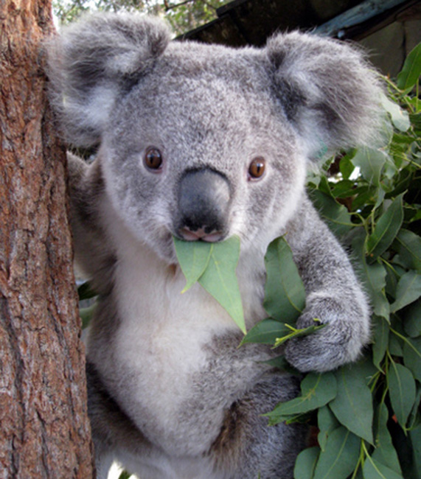
Open your books at p. 71
-What is the animal in the picture? -Where does it live? -What does it eat and drink?

Slide 4
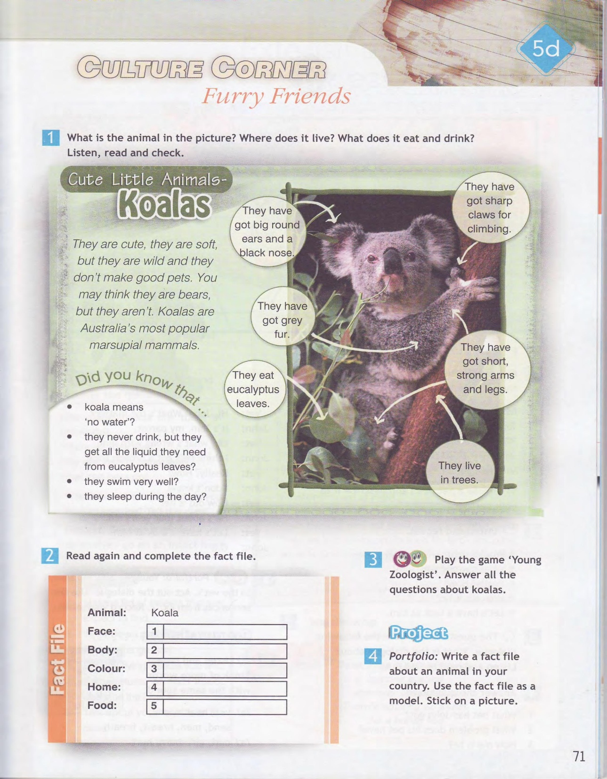

Slide 5
A. Koalas have got big round ears and a black nose.
B. They have got grey fur. C. They live in trees.
D. They eat eucalyptus leaves
E. They have got short, strong arms and legs.
Fact file: 1.Face 2.Body 3.Co lour 4.Home 5.Food
A
B
C
D
E

Slide 6
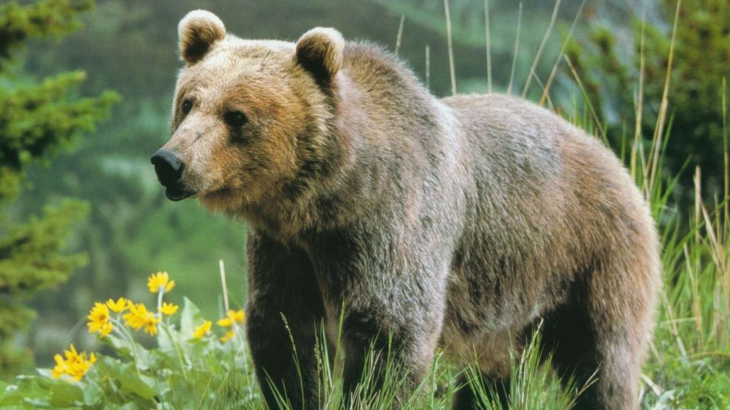
Lion Bear
Fact file
Face:
Body:
Colour:
Home:
Food:

